Slide 1
Database Management Systems
DBMS IT615
(3-0-2-4)
Minal Bhise
minal_bhise@daiict.ac.in
Faculty Block 1, Room 1209
Phone 548

Slide 2
Overview
Course Handout
  Resources
  Evaluation Scheme
Course Plan
  Course Overview

Slide 3
Resources
Text Book
  Silberschatz, Korth & Sudarshan, Database System Concepts, 7th Edition, McGraw-Hill, 2019
Additional Books
  Ramakrishnan & Gehrke, Database Management Systems, McGraw-Hill, 2003
  Elmasri & Navathe, Fundamentals of Database Systems, Pearson Education 1999
  Date C.J., An Introduction to Database Systems, Addison-Wesley, 2001
Lecture folder daiictpdc
Google classroom

Slide 4
Operational Details
Class
  (Tuesday)11:00am, (Wednesday, Friday) 12:00 noon @ CEP 207
Lab Work
  2 hours/ week
  Each Lab will be evaluated. Student must attend and complete each lab in order to even pass the course
Lecture attendance policy as declared by the institute
Exams
  MidSem Exam
  EndSem Exam

Slide 5
Evaluation Scheme
Labs and Assignments 30%
Mid Term Test 30%
Final Test 40%

Slide 6
Course Policy
Attendance in Lectures below 70% will lead to a FAIL grade in the course.
Student will be evaluated during each lab.
Each Lab submission will be evaluated. Student has to complete all the lab assignments and evaluations in order to pass the course.

Slide 7
Database and DBMS
Database System DBS
  Collection of interrelated data, describing activities of one or more related organizations.
  Example: DAIICT database contains information about students, faculty, courses, classrooms, exams
  Set of programs to access those data
Database Management System DBMS is a software designed to assist in maintaining and utilizing large collections of data
Alternative is to store the data in files and use application specific codes

Slide 8
Data Management
Defining structures for data storage
Providing mechanism for accessing this information

Slide 9
Database Systems
DBMS contains information about a particular enterprise
  Collection of interrelated data
  Set of programs to access the data
  An environment that is both convenient and efficient to use
Database systems are used to manage collections of data that are:
  Highly valuable
  Relatively large
  Accessed by multiple users and applications, often at the same time.
A modern database system is a complex software system whose task is to manage a large, complex collection of data.
Databases touch all aspects of our lives

Slide 10
Why Study Databases?
Shift from computation to information
Volume, velocity, and variety of data
Digital libraries, biological databases

Slide 11
Databases Everywhere!!!
Database Applications
  Banking: all transactions
  Airlines: reservations, schedules
  Universities: registration, grades
  Sales: customers, products, purchases
  Online retailers: order tracking, customized recommendations
  Manufacturing: production, inventory, orders, supply chain
  Human resources: employee records, salaries, tax deductions
  Databases touch all aspects of our lives

Slide 12
DBMS Functionalities
Define a database : in terms of data types, structures and constraints
Construct or Load the Database on a secondary storage medium
Manipulating the database : querying, generating reports, insertions, deletions and modifications to its content
Concurrent Processing and Sharing by a set of users and programs – yet, keeping all data valid and consistent
Crash Recovery

Slide 13
The DBMS Marketplace
Relational DBMS companies – Oracle, Sybase – are among the largest software companies in the world.
IBM offers its relational DB2 system. With IMS, a nonrelational (hierarchical) system, IBM is by some accounts the largest DBMS vendor in the world.
Microsoft offers SQL-Server, plus Microsoft Access for the cheap DBMS on the desktop
Relational companies also challenged by object-oriented DB companies.
But countered with object-relational systems, which retain the relational core while allowing type extension as in OO systems.

Slide 14
Studying DBMS
Modeling and design of databases
  Data, Structuring the data
(2) Programming
  queries and DB operations like update
  SQL (DDL, DML)
(3) DBMS implementation
IT615 = (1) + (2), while (3) is covered partly

Slide 15
Course Plan
Database Overview
  Basic Definitions, Data Storage, Data Models, Queries, Query Optimization, Transaction Management, Distributed Databases
What Data? Requirements Collection and Analysis
Structuring Data (Data models)
  E-R Model, Conceptual Design using E-R Model
  Relational Model
    introduction, database architecture, integrity constraints, database design
Query Languages: Relational Algebra, SQL
Conceptual Database Design & Tuning
  relational data model
  FD, Normal Forms, Decomposition, Normalization, Schema Refinement
Notes:
Vdcrxr

Slide 16
Course Plan
Physical Database Design
  Data Storage and Query Processing, Indexing
Transaction Management
  ACID Properties, Concurrency Control, Crash Recovery
Distributed and Parallel Databases
  Data Storage and Query Processing
Oracle, postgresql/ postgres

Slide 17
Purpose and Nature of
Database Systems

Slide 18
Early Days Database Applications
Data redundancy and inconsistency
  data is stored in multiple file formats resulting in duplication of information in different files
Difficulty in accessing data
  Need to write a new program to carry out each new task
Data isolation
  Multiple files and formats
Integrity problems
  Integrity constraints (e.g., account balance > 0) become “buried” in program code rather than being stated explicitly
  Hard to add new constraints or change existing ones

Slide 19
Early Days Database Applications
Atomicity of updates
  Failures may leave database in an inconsistent state with partial updates carried out
  Example: Transfer of funds from one account to another should either complete or not happen at all
Concurrent access by multiple users
  Concurrent access needed for performance
  Uncontrolled concurrent accesses can lead to inconsistencies
    Ex: Two people reading a balance (say 100) and updating it by withdrawing money (say 50 each) at the same time
Security problems
  Hard to provide user access to some, but not all, data

Slide 20
Database Systems
Database systems offer solutions to these problems
  Data redundancy & inconsistency
  Data access
  Data isolation
  Integrity problems
  Atomicity of updates
  Concurrent accesses by multiple users
  Security issues

Slide 21
University Database Example
Data consists of information about
  Students
  Instructors
  Classes
Application program examples
  Add new students, instructors, and courses
  Register students for courses, and generate class rosters
  Assign grades to students, compute grade point averages (GPA) and generate transcripts

Slide 22
What is a DBMS?
A very large integrated collection of data
Models real world entities
Database Management System DBMS is software designed to assist in maintaining and utilizing large collections of data

Slide 23
Advantages of a DBMS
Program-Data Independence
  Insulation between programs and data: Allows changing data storage structures and operations without having to change the DBMS access programs.
Efficient Data Access
  DBMS uses a variety of techniques to store & retrieve data efficiently
Data Integrity & Security
  Before inserting salary of an employee, the DBMS can check that the dept. budget is not exceeded
  Enforces access controls that govern what data is visible to different classes of users

Slide 24
Advantages of a DBMS
Data Administration
  When several users share data , centralizing the administration offers significant improvement
Concurrent Access & Crash Recovery
  DBMS schedules concurrent access to the data in such a manner that users think of the data as being accessed by only one user at a time
  DBMS protects users from the ill-effects of system failures
Reduced Application Development Time
  Many important tasks are handled by the DBMS

Slide 25
Data Models
Structuring the Data

Slide 26
Data Models
A data model is collection of concepts for describing data
A schema is a description of a particular collection of data, using the given data model
A relational data model is the most widely used data model today
Network Model, Hierarchical Model, Object-Oriented Model, Relational Model, Knowledge Bases , XML, RDF, OWL, Graph Databases

Slide 27
Data Models
Relational Model ( E.F.Codd 1970)
  Relation is a table with rows and columns
  Every relation has a schema that describes the columns or fields
Relational model is good for:
  Large amounts of data, simple operations
  Navigate among small number of relations
  Difficult Applications for relational model
    VLSI Design (CAD in general)
    CASE
    • Graphical Data

Slide 28
Data Models
Where number of relations is large, relationships are complex
  Object Data Model
Object Data Model
    Complex Objects – Nested Structure (pointers or references)
    Encapsulation, set of Methods/Access functions
    Object Identity
    Inheritance – Defining new classes like old classes

Slide 29
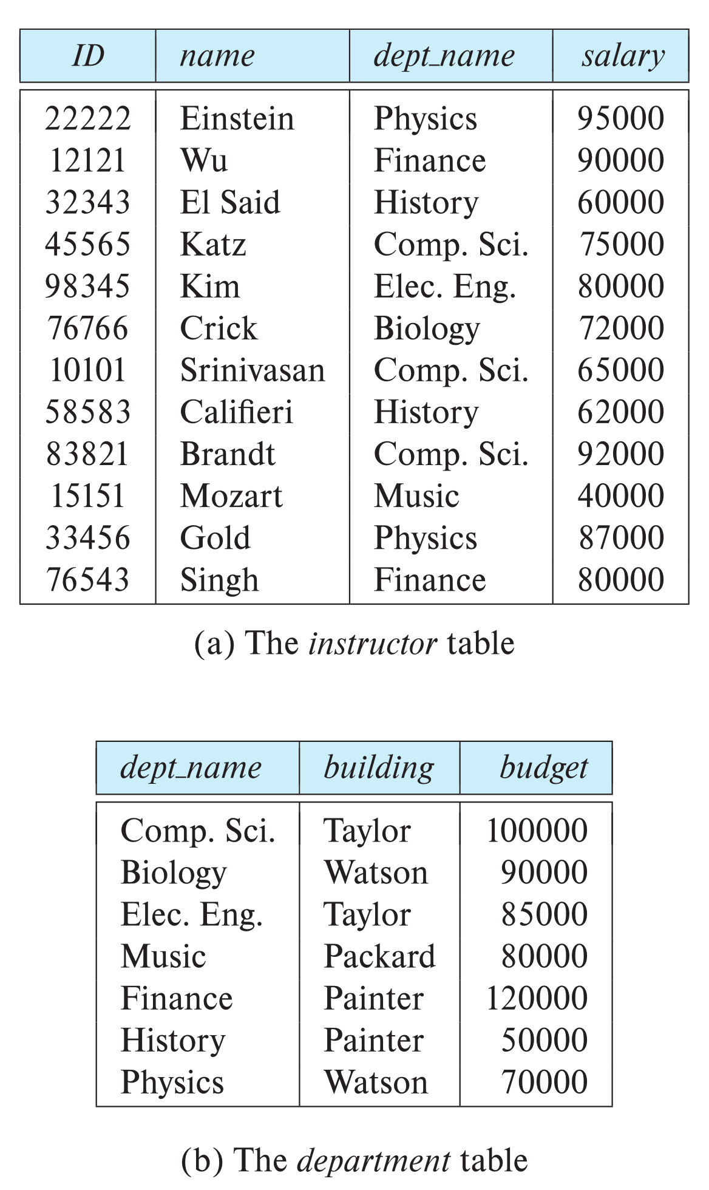

Relational Model
All the data is stored in various tables.
Example of tabular data in the relational model
Columns
Rows
Ted Codd
Turing Award 1981

Slide 30
A Sample Relational Database

Slide 31
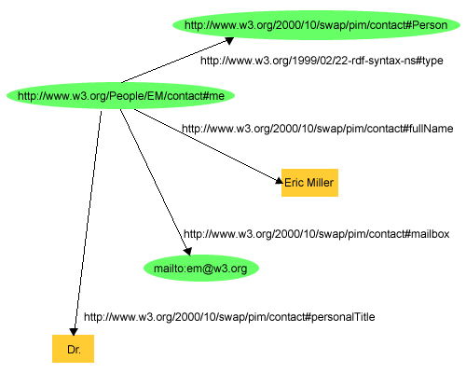
RDF Model

Slide 32

Levels of Abstraction
Databases provide users with an abstract view of data

Slide 33
3 Levels of Abstraction
Physical or Internal Level
  Lowest level of abstraction describes how data are actually stored
  Describes complex low-level data structures in detail
Logical or Conceptual Level
  Describes what data are stored in the DB & what relationships exist among those data
  Describes the entire DB in terms of relatively simpler structures
View or External Level
  Highest level of abstraction which describes only a part of the DB
  User’s view of the DB. This level describes part of the DB that is relevant to each user

Slide 34
Data Independence
Applications insulated from how data is structured and stored
Logical data independence: Protection from changes in logical structure of data
Physical data independence: Protection from changes in physical structure of data

Slide 35
Levels of Abstraction
View 1
View 2
View 3
Many views, single conceptual (logical) schema and physical schema
  Views describe how users see the data
  Conceptual schema defines logical structure
  Physical schema describes the files and indexes used
Conceptual Schema
Physical Schema
Schemas are defined using DDL; data is modified/queried using DML

Slide 36
Instances and Schemas
Logical Schema – the overall logical structure of the database
  Example: The database consists of information about a set of customers and accounts in a bank and the relationship between them
    Analogous to type information of a variable in a program
Physical schema – the overall physical structure of the database, indexes, space allocation, data compression, encryption, access paths
  DBMS: Data access optimized and storage minimized
Instance – the actual content of the database at a particular point in time
  Analogous to the value of a variable

Slide 37
Example : University Database
Conceptual schema:
  Students(sid: string, name: string, login: string,
  age: integer, gpa:real)
  Courses(cid: string, cname:string, credits:integer)
  Enrolled(sid:string, cid:string, grade:string)
Physical schema:
  Relations stored as unordered files
  Index on first column of Students
External Schema (View):
  Course_info(cid:string,enrollment:integer)

Slide 38
Physical Data Independence
Applications insulated from how data is structured and stored
Logical data independence: Protection from changes in logical structure of data
Physical data independence: Protection from changes in physical structure of data
  the ability to modify the physical schema without changing the logical schema
  In general, the interfaces between the various levels and components should be well defined so that changes in some parts do not seriously influence others.

Slide 39
ANSI/SPARC 3-Tier Architecture
User 1
User 2
User n
External Level
View 1
View 2
…
View n
E/C Mapping
Logical DI
Conceptual/Logical Level
Conceptual Schema
Physical DI
C/I Mapping
Internal Level
Physical Schema
Database

Slide 40
ANSI-SPARC Architecture
Separates users’ view from the way in which the data is arranged physically or logically
It hides the physical storage details from users: Users should not have to deal with physical database storage details. They should be allowed to work with the data itself, without concern for how it is physically stored
The database administrator should be able to change the database storage structures without affecting the users’ views : From time to time changes to the structure of an organization's data will be required.
The internal structure of the database should be unaffected by changes to the physical aspects of the storage : For example, a changeover to a new disk.

Slide 41
Data Definition Language (DDL)
Specification notation for defining the database schema
  Example: create table instructor (
  ID char(5),
  name varchar(20),
  dept_name varchar(20),
  salary numeric(8,2))
DDL compiler generates a set of table templates stored in a data dictionary
Data dictionary contains metadata (i.e., data about data)
  Database schema
  Integrity constraints
    Primary key (ID uniquely identifies instructors)
  Authorization
    Who can access what

Slide 42
Data Manipulation Language (DML)
Language for accessing and updating the data organized by the appropriate data model
  DML also known as query language
There are basically two types of data-manipulation language
  Procedural DML -- require a user to specify what data are needed and how to get those data.
  Declarative DML -- require a user to specify what data are needed without specifying how to get those data.
Declarative DMLs are usually easier to learn and use than are procedural DMLs.
Declarative DMLs are also referred to as non-procedural DMLs
The portion of a DML that involves information retrieval is called a query language.

Slide 43
SQL Query Language
SQL query language is nonprocedural. A query takes as input several tables (or only one) and always returns a single table.
Example to find all instructors in Comp. Sci. dept
select name
from instructor
where dept_name = 'Comp. Sci.‘
To be able to compute complex functions SQL is usually embedded in some higher-level language
Application programs generally access databases through one of
  Language extensions to allow embedded SQL
  Application program interface API (e.g., ODBC/JDBC) which allow SQL queries to be sent to a database

Slide 44
Database Access from Application Program
SQL does not support actions such as input from users, output to displays, or communication over the network.
Such computations and actions must be written in a host language, such as C/C++, Java or Python, with embedded SQL queries that access the data in the database.
Application programs -- are programs that are used to interact with the database in this fashion.

Slide 45
Database Design
Logical Design – Deciding on the database schema. Database design requires that we find a “good” collection of relation schemas.
  Business decision – What attributes should we record in the database?
  Computer Science decision – What relation schemas should we have and how should the attributes be distributed among the various relation schemas?
Physical Design – Deciding on the physical layout of the database

Slide 46
Database Engine
A database system is partitioned into modules that deal with each of the responsibilities of the overall system.
The functional components of a database system can be divided into
  The storage manager
  The query processor component
  The transaction management component

Slide 47
Storage Manager
A program module that provides the interface between the low-level data stored in the database and the application programs and queries submitted to the system.
The storage manager is responsible to the following tasks:
  Interaction with the OS file manager
  Efficient storing, retrieving and updating of data
The storage manager components include:
  Authorization and integrity manager
  Transaction manager
  File manager
  Buffer manager

Slide 48
Storage Manager
The storage manager implements several data structures as part of the physical system implementation:
  Data files -- store the database itself
  Data dictionary -- stores metadata about the structure of the database, in particular the schema of the database.
  Indices -- can provide fast access to data items. A database index provides pointers to those data items that hold a particular value.

Slide 49
Query Processor
  DDL interpreter -- interprets DDL statements and records the definitions in the data dictionary.
  DML compiler -- translates DML statements in a query language into an evaluation plan consisting of low-level instructions that the query evaluation engine understands.
    The DML compiler performs query optimization; that is, it picks the lowest cost evaluation plan from among the various alternatives.
  Query evaluation engine -- executes low-level instructions generated by the DML compiler.

Slide 50

Query Processing
1. Parsing and translation
2. Optimization
3. Evaluation

Slide 51
Transaction Management
A transaction is a collection of operations that performs a single logical function in a database application
Transaction-management component ensures that the database remains in a consistent (correct) state despite system failures (e.g., power failures and operating system crashes) and transaction failures.
Concurrency-control manager controls the interaction among the concurrent transactions, to ensure the consistency of the database.

Slide 52
Concurrency Control
Concurrent execution of user program is essential for good DBMS performance
  Because disk accesses are frequent, and relatively slow, it is important to keep the cpu working on several user programs concurrently
Interleaving actions of different user programs can lead to inconsistencies
DBMS ensures such problems don’t arise: users can pretend they are using a single-user system

Slide 53
History of Database Systems
1950s and early 1960s:
  Data processing using magnetic tapes for storage
    Tapes provided only sequential access
  Punched cards for input
Late 1960s and 1970s:
  Hard disks allowed direct access to data
  Network and hierarchical data models in widespread use
  Ted Codd defines the relational data model
    Would win the ACM Turing Award for this work
    IBM Research begins System R prototype
    UC Berkeley (Michael Stonebraker) begins Ingres prototype
    Oracle releases first commercial relational database
  High-performance (for the era) transaction processing

Slide 54
History of Database Systems
1980s:
  Research relational prototypes evolve into commercial systems
    SQL becomes industrial standard
  Parallel and distributed database systems
    Wisconsin, IBM, Teradata
  Object-oriented database systems
1990s:
  Large decision support and data-mining applications
  Large multi-terabyte data warehouses
  Emergence of Web commerce

Slide 55
History of Database Systems
2000s
  Big data storage systems
    Google BigTable, Yahoo PNuts, Amazon,
    “NoSQL” systems.
  Big data analysis: beyond SQL
    Map reduce
2010s
  SQL reloaded
    SQL front end to Map Reduce systems
    Massively parallel database systems
    Multi-core main-memory databases

Slide 56
Summary
DBMS is used to maintain, query large volume of data
Benefits of DBMS include recovery from system crashes, concurrent access, quick application development, data integrity and security
Levels of abstraction give data independence
A DBMS typically has a layered architecture

